Slide 1

Sports Analytics II
Produced by Dr. Mario
UNC STOR 390

Slide 2

Data Management
Different Sources: What are some examples?
Quantitative and Qualitative
Objective and Subjective
Text and Images and Video
Increasing Number of Sources
Increasing Volume from Those Sources
Data Comes Structured and Unstructured
Structured is Easier to Analyze
Unstructured is More Flexible

Slide 3
Data Management
Process of Data Management
Standardization
Purpose: To Make Combining Data Easy
Know All Sources of Data in the Organization
Create a Data Inventory: Variable, Description, Format
Different Departments, but Same Format
Standardization
Centralization
Integration

Slide 4
Data Management
Centralization
Purpose: To Make Acquiring Data Easy
Stored and Protected in the Same Location
Accessible by All Decision Makers
Continual Assessment of Data Quality Via Multiple Eyes
Integration
Purpose: To Make Analyzing Data Easy
Merging/Linking Data According to Unique Identifiers
Examples: What Insights Could Be Learned?
Training Staff Data and Coaching Staff Data
Scouting Data and Play-by-Play Data
Marketing Data and Salary Data

Slide 5
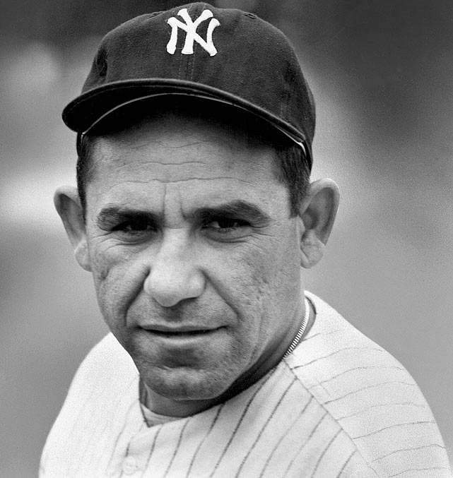
Analytic Models
Process of Predictive Analytics
Consider the Research Question or Problem
Identify or Create Dependent Variables of Interest
Incorporate All Information
Find Relationships (Linear/Nonlinear)
Evaluate Model, Report, and Repeat
Prediction is difficult,
especially about the future. -Yogi Berra

Slide 6

Analytic Models
Question Quality Influences Analysis Quality
Tangible Versus Intangible
How effective is Serena’s serve when behind in sets?
How much stress does Serena put on her opponent?
Informational Versus Predictive
What information influences Serena’s likelihood of winning a match?
How successful will Serena be next year?

Slide 7
Analytic Models
Short Course on Sports Analytics
Mike Lewis, Goizueta Business School, Emory
Two Types of Projects
Long-Term
Short-Term
Analyses Should be Used to Evaluate Decision Biases
Big Data Problem
Number of Variables Increasing
Number of Players Remains the Same

Slide 8
Analytic Models
Fundamentals on Sports Analytics
Mike Lewis, Goizueta Business School, Emory
Metrics AKA Quantifiable Measures
Understand the Past, Evaluate the Present, Predict the Future
Four Phase Process by Ben Alamar
Opportunity, Survey, Analysis, Communication
Metrics Must be Explainable and Testable
Statistical Model Essentials
Linear Regression
Generalized Linear Models

Slide 9
Analytic Models
Analytics don’t work at all.
It’s just some crap that people who were really smart made up to try to get in the game because they had no talent.
-Sir Charles Barkley

Slide 10
Analytic Models
Five Questions for All Analyses – Ben Alamar
What was the thought process that led to the analysis?
What is the context of the result?
How much uncertainty is in the analysis?
How does the result inform the decision-making process?
How can we further reduce the uncertainty?

Slide 11
Analytic Models
Analytics will almost never outperform human judgment when it comes to individuals. What analytics are useful for is helping human decision makers self-correct.
-Mike Lewis

Slide 12
Information Systems
Mechanisms for Data Delivery
Organization and Presentation Matters
“One Version of the Truth” – Ben Alamar
Static: Automatically Generated Reports
Interactive: Computer, Phone, Tablet, and Web Applications

Slide 13
Analytics In the Organization
On-the-Field
Coaching
Player Development
Player Evaluation
Off-the-Field
Sales
Marketing
Cap Management
Hiring
Public Relations and Social Media

Slide 14
Analytics Across the Organizations
Sports Analytics Use Survey (2013)
Sample of 27 People (NFL, MLB, NBA, EPL)
How Many Different Sources?
1-2 (6.7%)
3-4 (33.3%)
5-6 (13.3%)
>6 (46.71%)

Slide 15
Analytics Across the Organizations
How Much Data is Centralized?
All (31.3%)
Most (37.4%)
Some (31.3%)
How Much Data is Dependent on One Person?
Some (50.0%)
Most (43.7%)
All Data Centralized (6.3%)

Slide 16
Analytics Across the Organizations
Is Data Checked for Errors?
Always (31.3%)
Usually (37.5%)
Sometimes (18.8%)
Occasionally (6.1%)
Rarely (6.3%)
How Many Database Programmers are Employed?
0 (37.5%)
1-2 (50.0%)
3-4 (0.0%)
>5 (12.5%)

Slide 17
Analytics Across the Organizations
How Many Statistical Analysts are Employed?
0 (20.0%)
1-2 (66.6%)
3-4 (0.0%)
>5 (13.3%)
Roadblock: Difficulty Identifying Strong Applicant
Difficulty in Both Hiring and Evaluating

Slide 18
Analytics Across the Organizations
Clear Process for Hiring/Evaluating Analysts
Strongly Agree (13.3%/14.3%)
Somewhat Agree (13.3%/14.3%)
Neutral (26.7%/28.6%)
Somewhat Disagree (13.4%/21.4%)
Strongly Disagree (33.3%/21.4%)
Analytic Resources in Line with Strategic Game Plan
Strongly Agree (26.7%)
Somewhat Agree (33.3%)
Neutral (33.3%)
Strongly Disagree (6.7%)

Slide 19
Final Inspiration
I am not cocky. I am 95% confident.
- Mahatma Mario

